Slide 1

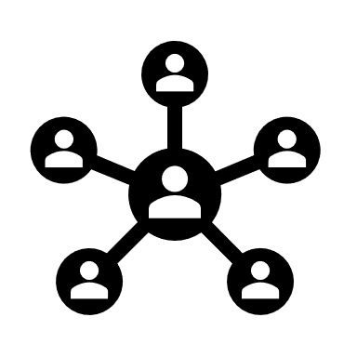

Team name : Hashcoders Team code: A1CB1-CC13

Slide 2


Deploying a static website on cloud platform

Slide 3
Agenda
Problem statement
What is cloud computing
Who are the end users
Solutions
Wow in the solutions
Modelling
Results

Slide 4

Problem statement
Increased complexity of the application deployments, Database management, non-scalable infrastructure and outdated functionality prompted the need of a well structured platform.

Slide 5

Project overview
A cloud website is an Internet-based program where a couple of the processing logic and data accumulating, is deal with in the cloud. The clients communicate with the website using an internet browser or a mobile application, and the data processing is administered by a local device and computing solution. From the client's perspective, the cloud website continues like a standard website,

Slide 6
where the data processing is deal with the cloud through an API or a mixture of both. Cloud apps has several benefits like reduced software costs, control, security, and reduced management cost. Cloud applications have different categories, and they are Software-as-a-Service (SaaS), Platform-as-a-Service (PaaS) and Infrastructure-as-a-Service (IaaS). The most popular approaches to developing a website is by using HTML, CSS, and JavaScript.
These three programming languages helps to create an interactive and browser-based web app.

Slide 7
HTML is the structure or the foundation of the website and it adds content to the webpages. The CSS is used to give the style to a website, and it adds presentation to the content of the webpages.
Some cloud platforms are Heroku, Google cloud platform, Microsoft Azure, etc

Slide 8

Who are the end users
To this project the users will be the people who wants to know what really is cloud computing, and with a knowledge related to PaaS, IaaS, etc.
The people who wants to know how cloud computing work

Slide 9

Solution and its value proposition
The solution we tend to provide is a category of cloud known as Platform-as-a-service(PaaS). It is a distributed computing model that gives clients a total platform-hardware, programming, and framework for creating, running, and overseeing applications without the cost, multifaceted nature, and resoluteness of building and maintaining that platform on-premises.
The PaaS service supplier hosts everything including servers, storage, working framework programming, and information bases at their data centre.

Slide 10
The client utilizes it just for a month to month charge dependent on utilization and can buy more assets on-request.
The advantage of using PaaS is that it allows the user to build, deploy, update, maintain, test and scale the applications much more quickly and a lot cheaper than using their own platform to build and maintain the web apps or websites. The unique feature of the PaaS administration compared to others is that, it is the entire foundation platform rather than a specific application.

Slide 11
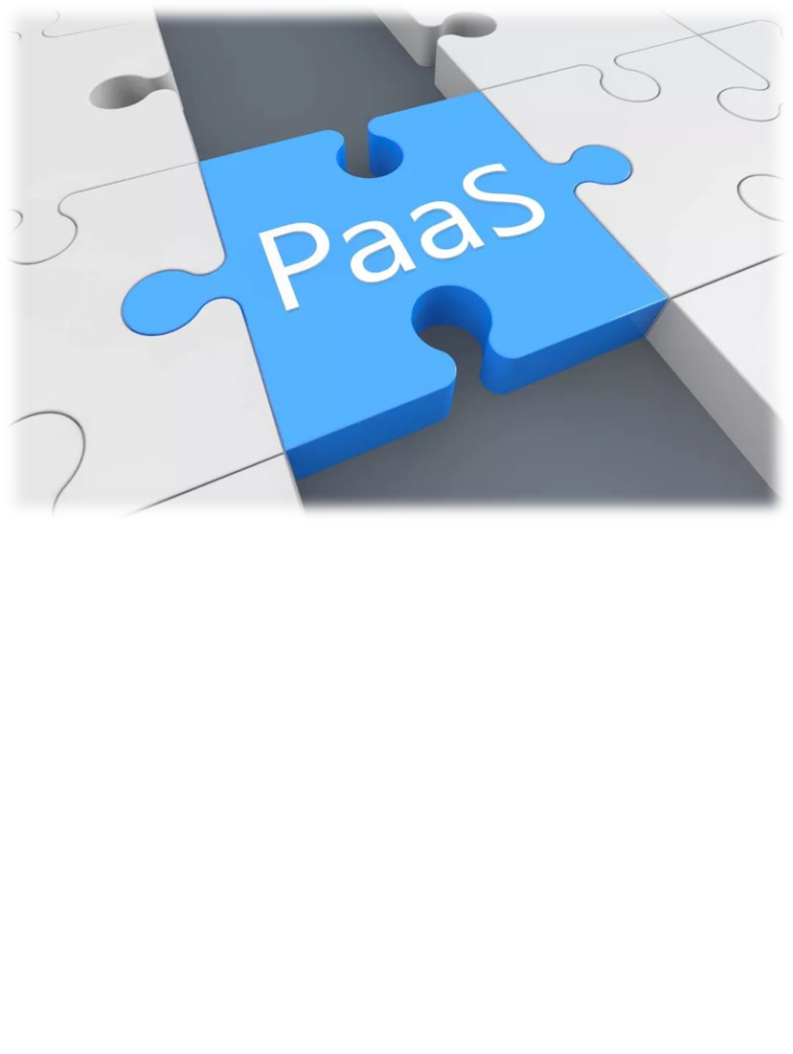
The platform service provider organizations are liable for building up and keeping up this platform and conveying it to the application framework suppliers through administrations.
Furthermore, PaaS suppliers likewise uphold specialized administrations, for example, application framework advancement and enhancement.
The technical support team from PaaS suppliers additionally encourage the cycle of innovative work in a new application framework to help with the steady and long-haul activity.

Slide 12
To prevent downtime, Almoayyed Computers obtained a backup copy of the redesigned MYS workload. The company then used Elastic Compute Cloud (AWS EC2) service to host the application’s AWS infrastructure, which included Amazon Simple Storage Service (Amazon S3) for object storage, Amazon CloudWatch and AWS CloudTrail for monitoring, and Amazon Relational Database (Amazon RDS). Almoayyed Computers Middle East (ACME) helped customer move mission critical workloads on AWS Cloud platform with near zero downtime. Leveraging their application development and networking expertise ACME has migrated MYS workloads securely.

Slide 13

The wow in the solution
The wow factor of the solution which is provided by us will be choosing the right category of the cloud services.
The substance of PaaS is to change Internet assets administrations into a programmable interface, supporting outsider designers with business significant assets and platform. With PaaS, designers can procure enormous programmable components that have an explicit business rationale to help advancement. This builds productivity besides it spares the expense.

Slide 14
Web applications could be created easily and react to clients more quickly.
PaaS has a unique service called middleware. Middleware is a program that sits in the middle of client confronting applications and the machine's working framework

Slide 15
Results
https://github.com/Sauravkumartopo/IBM_PROJECT-BY_Hashcoderz-
As a result of deploying the website we are able the decrease the complexity of downtime and a well structured storage service.

Slide 16
Our teams members
Harsha B.
Vaneesh verma.
Saurav kumar topo.
Nikita wani.
Raj Sawant.
Athish A.
Ayushi raj

Slide 17
Thank you

